Slide 1
HBA-VAN: Hierarchical Boundary-Aware Volumetric Attention Network for Multi-Modal Glioma Subregion Segmentation
Team 12
Jingxuan Zhang, Yatu Zhang, Yiwen Cai, Zidong Song

Slide 2
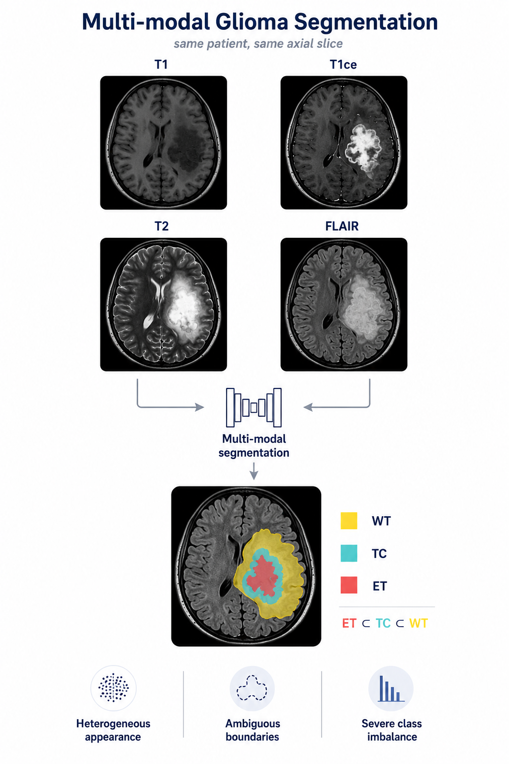
Background
Motivation:
automatically delineate tumor subregions from multi-modal MRI, supporting quantitative assessment and treatment planning.
Key challenge:
jointly identifying nested WT, TC, and ET regions despite heterogeneous appearance, ambiguous boundaries, and severe class imbalance.

Slide 3
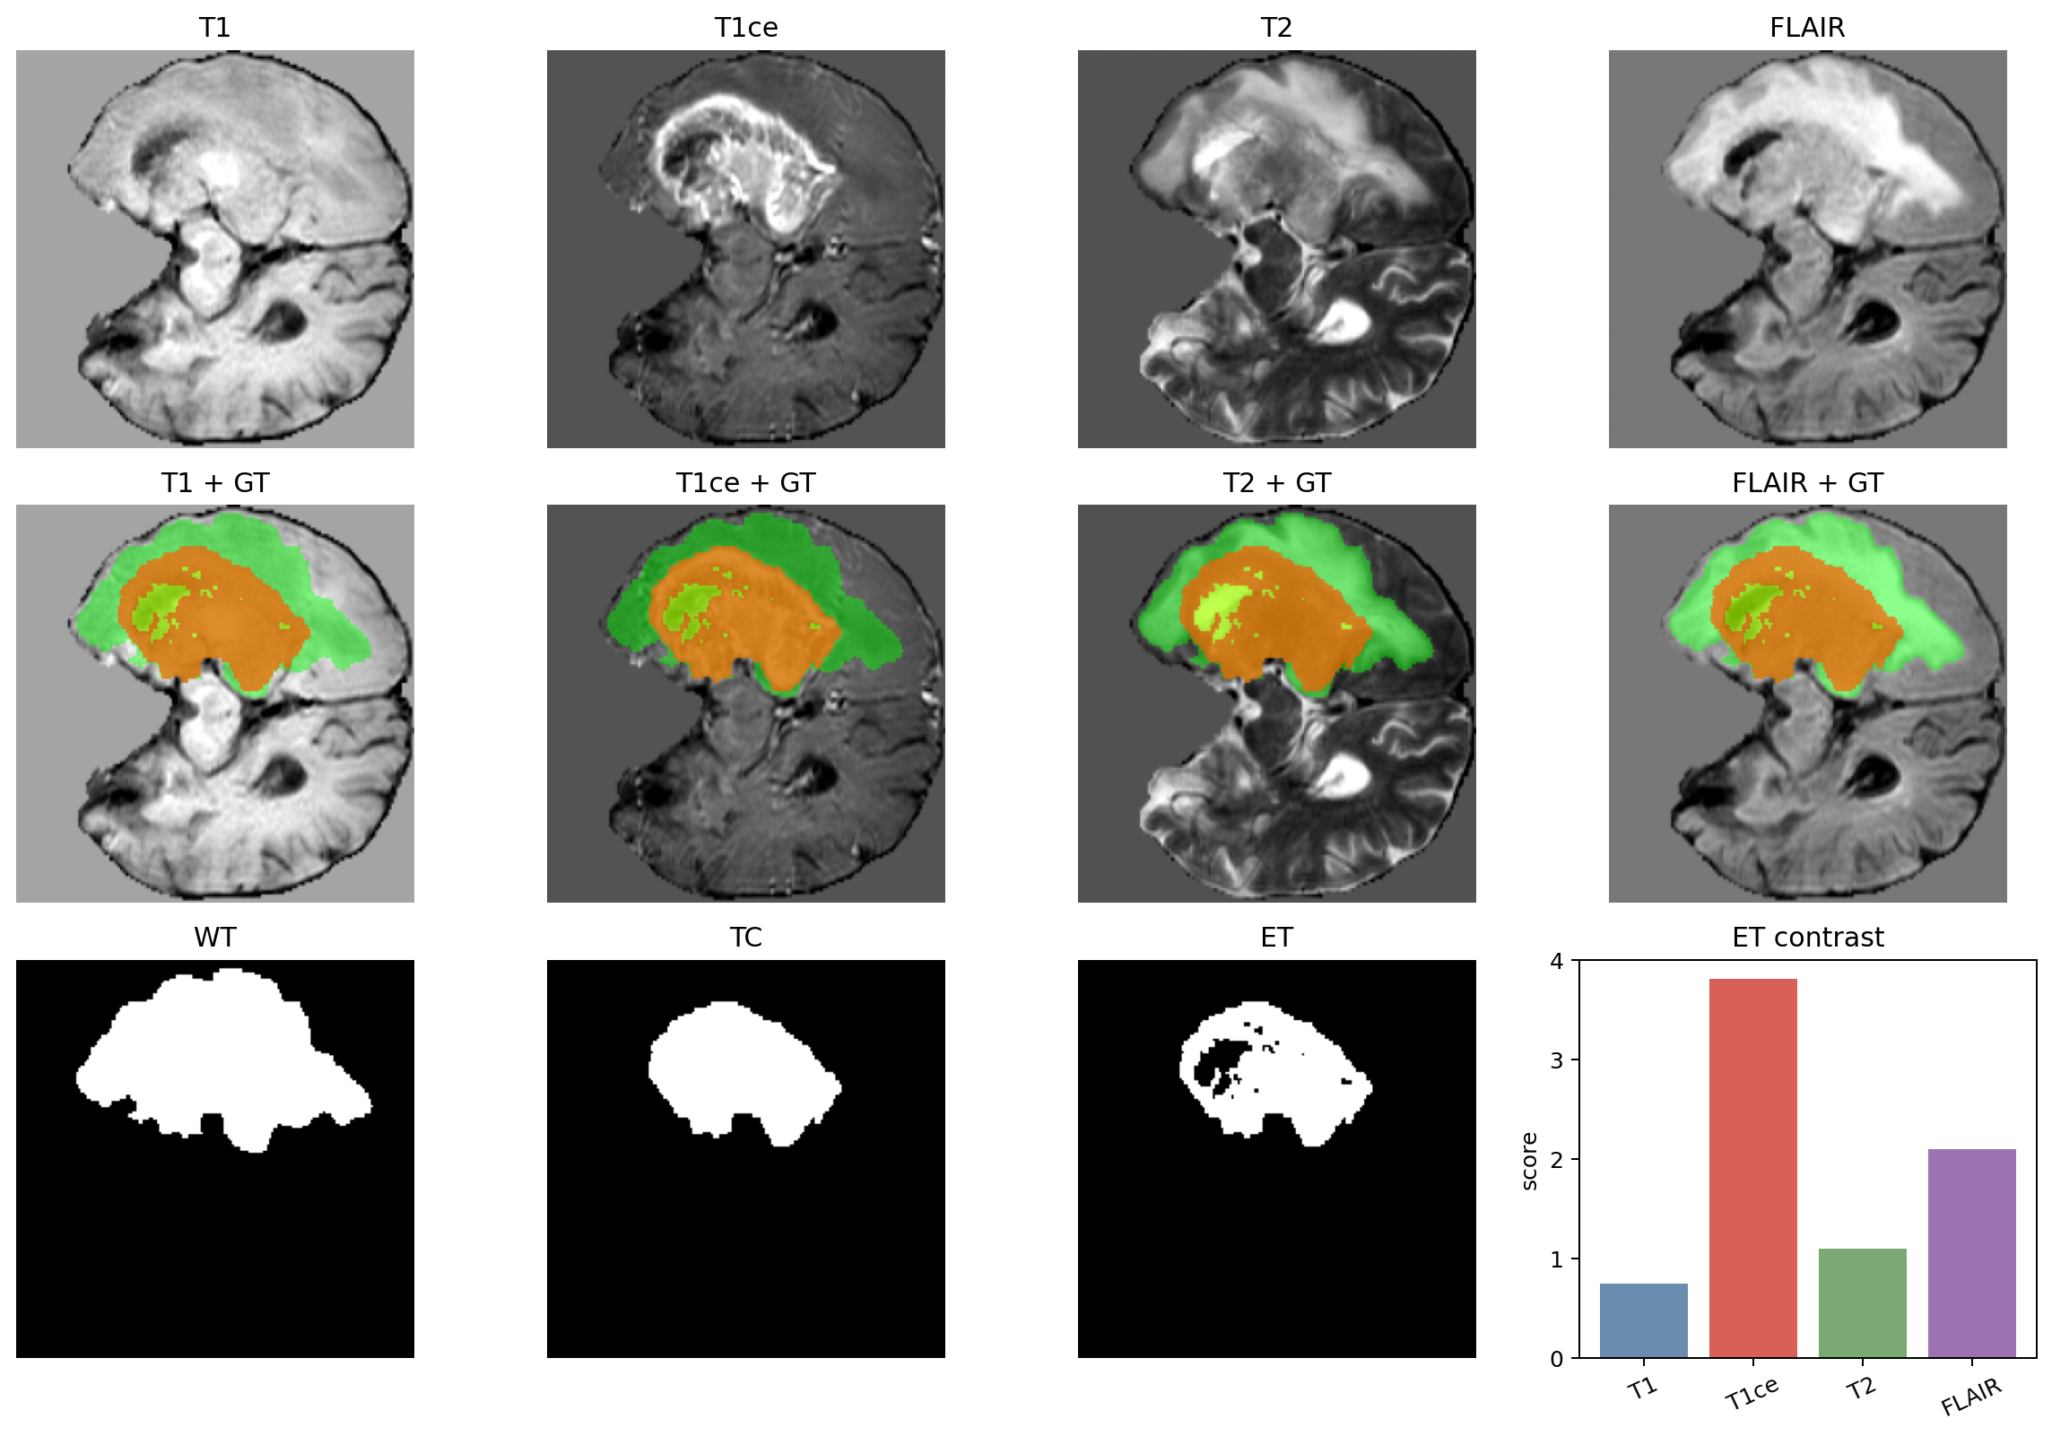
Task1: Data Preprocessing
NIfTI
4-channel
Crop
Normalize
Labels
Split
load volumes
stack modalities
nonzero brain
z-score brain voxels
WT / TC / ET
train / val / test
Region | Definition | Role
WT | all tumor | largest extent
TC | tumor core | compact lesion
ET | enhancing tumor | smallest / hardest
Region Info
Visualization
04

Slide 4
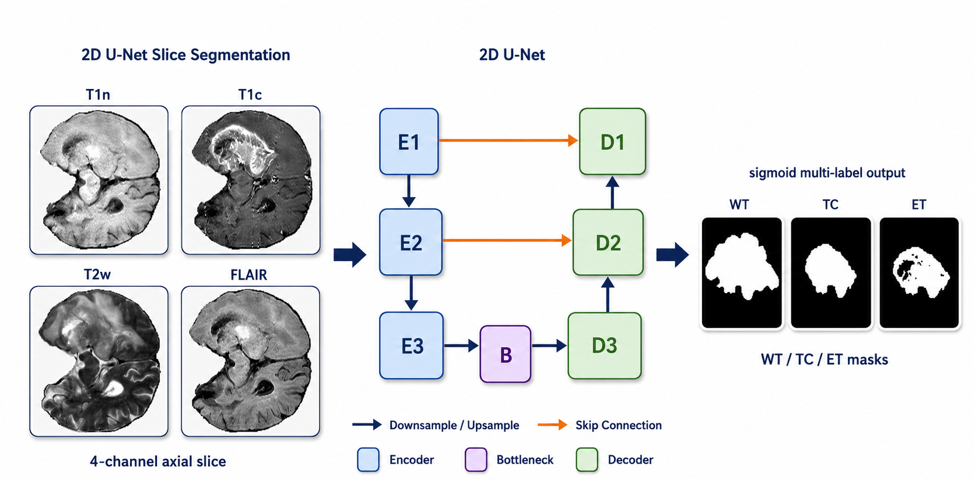
Task2: 2D U-Net

Slide 5
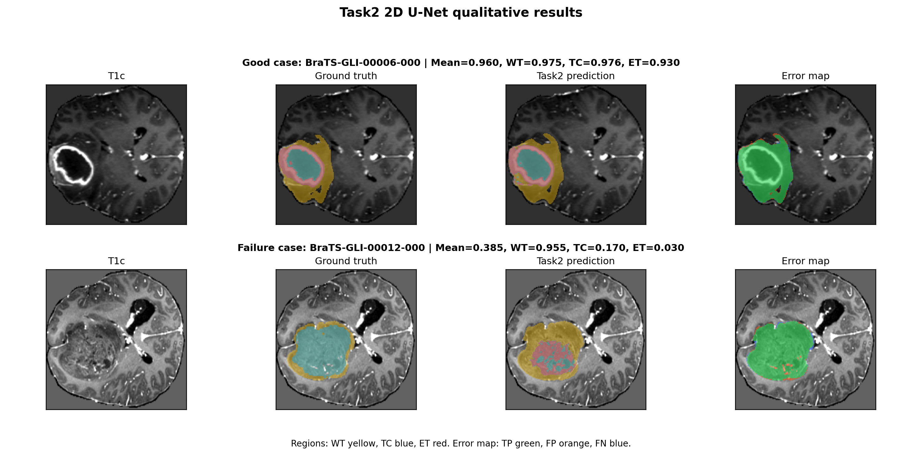
Task2: Result Analysis
Case-level Dice:
WT 0.9253
TC 0.9090
ET 0.8544
Mean 08962
HD95: 6.6879
Qualitive Result
Quantitive Result

Slide 6
Task3 Preliminary: 2.5D U-Net
Problem of 2D U-Net: Each axial slice is segmented independently.
Solution: Input multiple slices as context information.
Neighboring slices provide complementary evidence for small ET regions.
2.5D U-Net: Jointly processed 5 adjacent axial slices
Depth fusion introduces through-plane context
Remaining Problem? Cannot enforce global spatial consistency
Our final implementation: 3D Attention U-Net

Slide 7
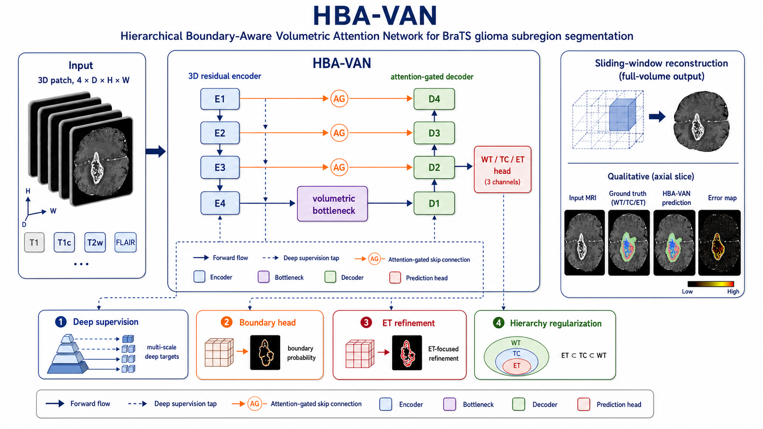
Task3: HBA-VAN pipeline

Slide 8
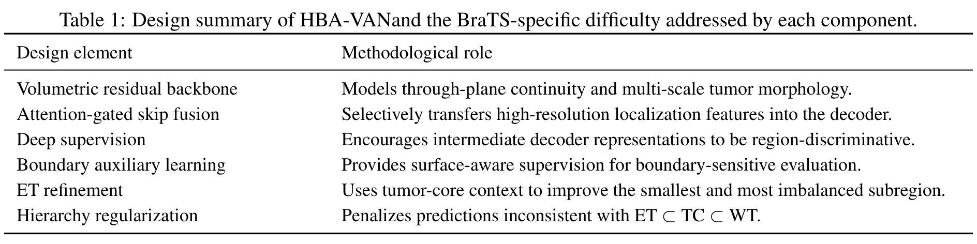
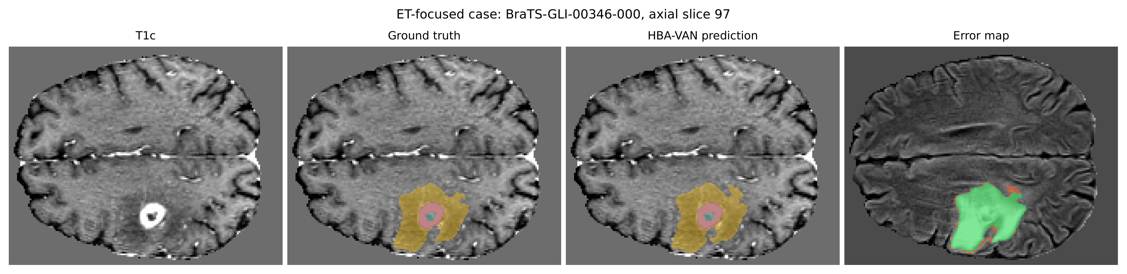
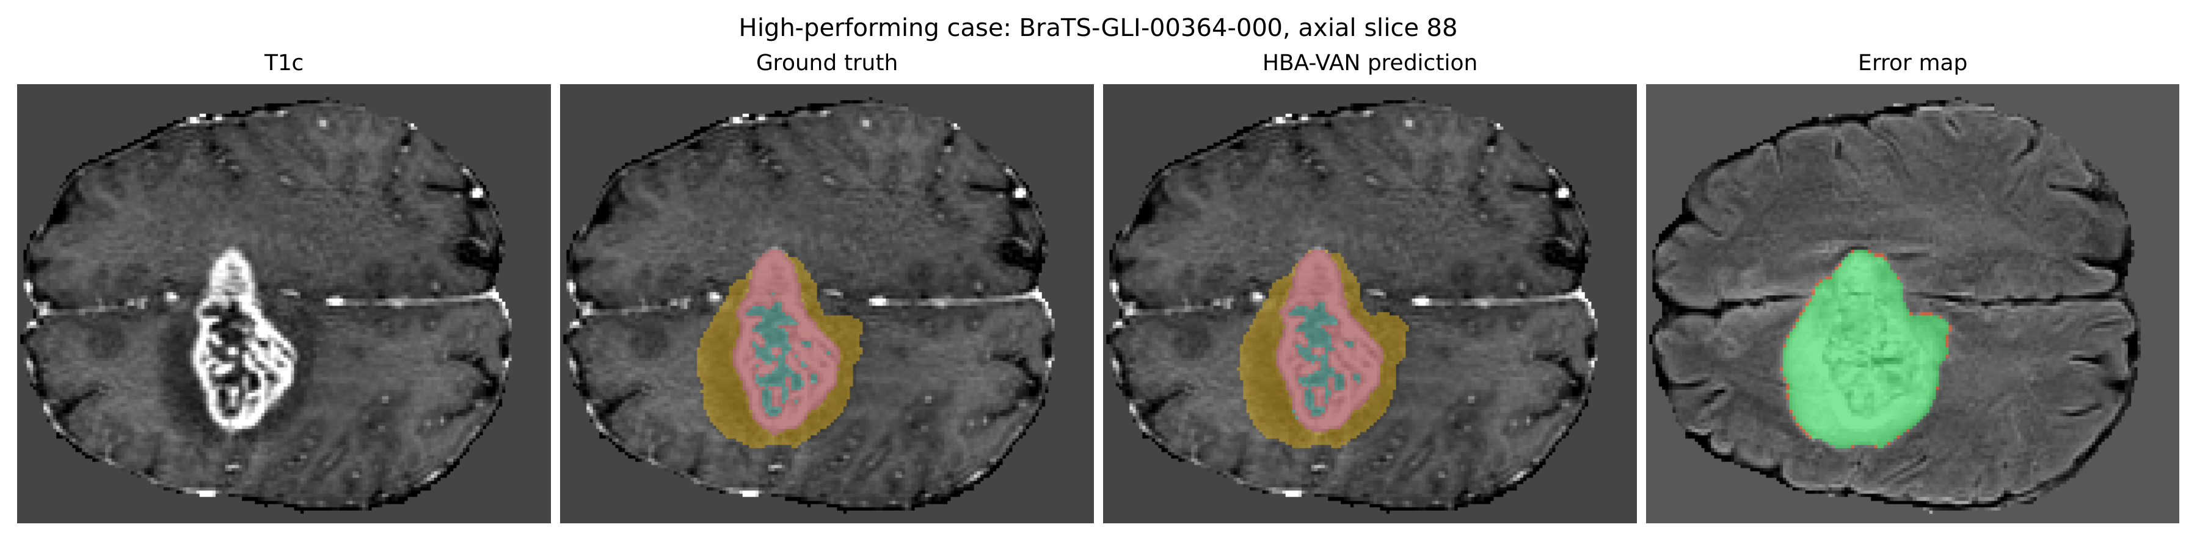
Design of HBA-VAN

Slide 9
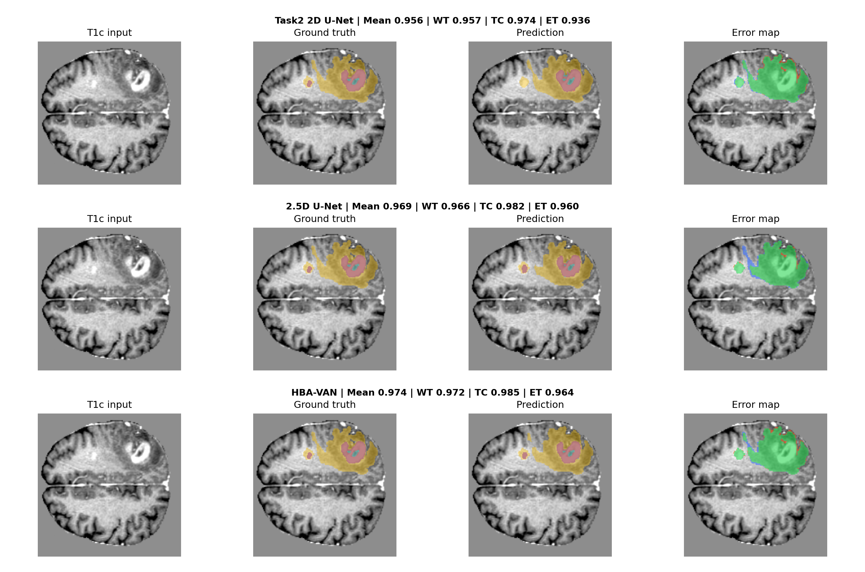
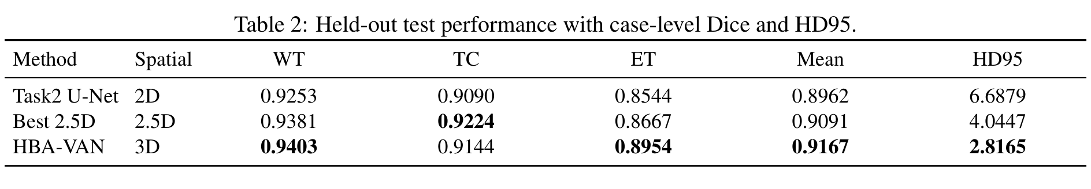
Comparative Experiments

Slide 10
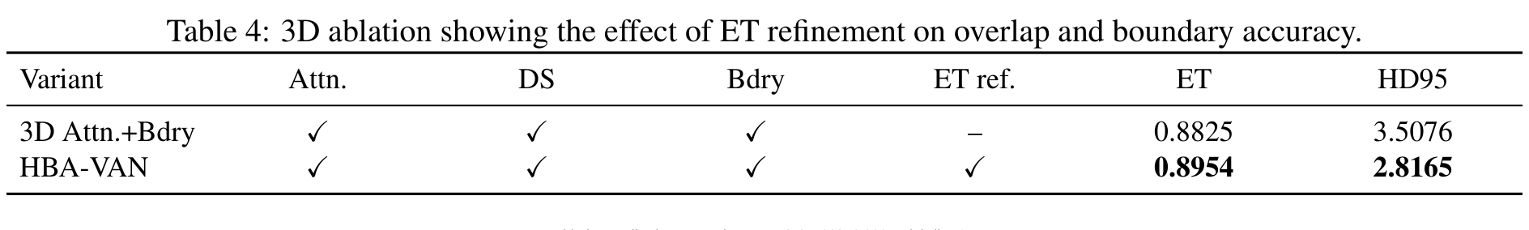
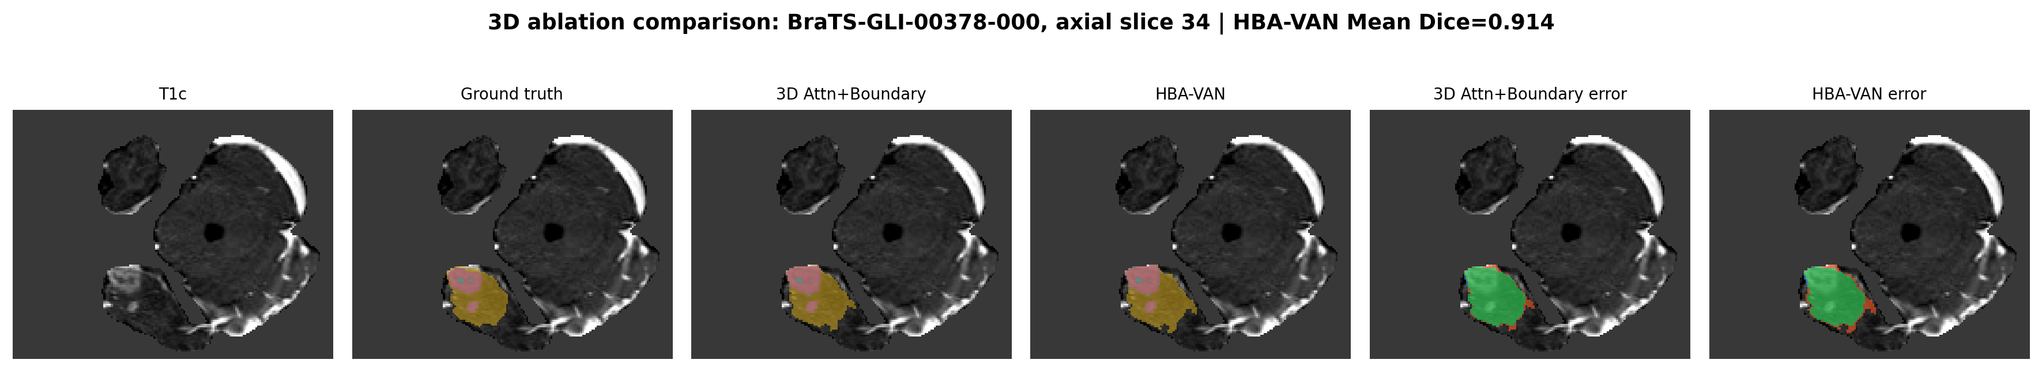
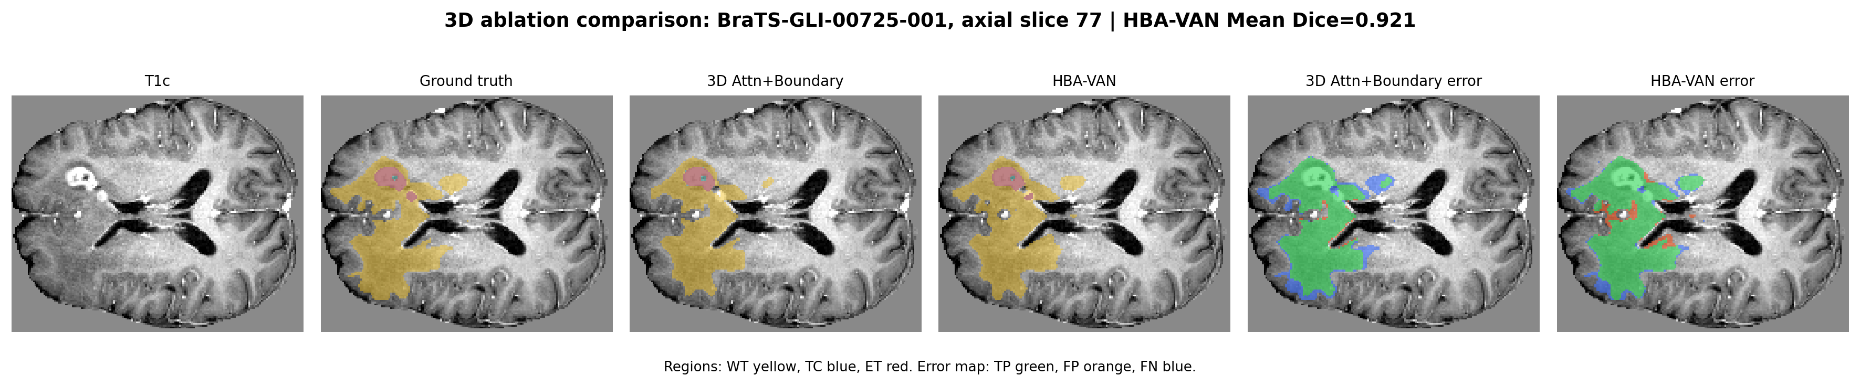
Ablation Study

Slide 11
Use of AI
Experiment Design
Part of the Network Component Design
Figure Drawing

Slide 12
Group Work Division
Jingxuan Zhang: Code implementation
Yatu Zhang: Data processing and Experiment design
Yiwen Cai: Slide and Figure
Zidong Sun: Report

